Slide 1
Chapter 1 Algorithm Design & Basics of Python Programs

Slide 2
Algorithms
1.1
An algorithm is a set of steps for solving a problem in the specified order. This process of comprehending an algorithm or a program is called “dry run”, which is a commonly used technique for deducing the purpose and output of an algorithm or a program.

Slide 3
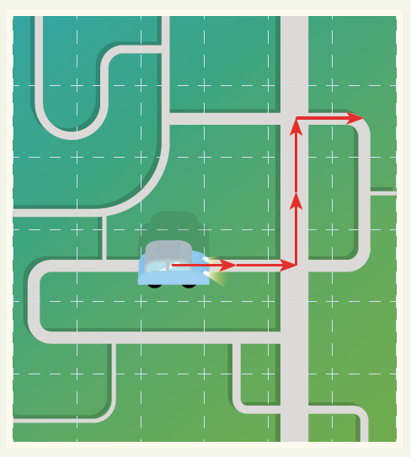
1.1

Slide 4
Input-Process-Output cycle
A
The Input-Process-Output cycle (IPO cycle) is a tool for problem analysis, as well as an important structure of an algorithm or a program.
• “Input” is the data to be used by the program;
• “Process” is the method adopted or procedure performed by theprogram;
• “Output” is the information returned by the program.

Slide 5
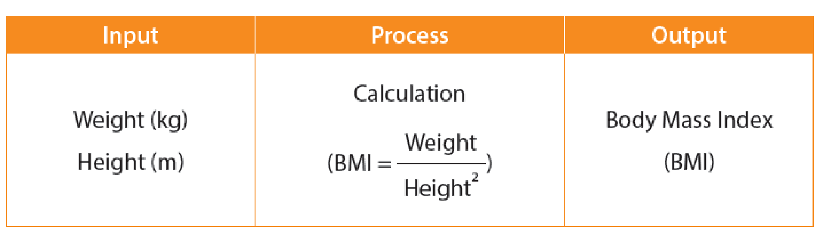
Input-Process-Output cycle
A
The following is a simple example, which is about writing an application to calculate the Body Mass Index (BMI, 身體質量指數) of human bodies for assessing the health of the user. The input, process and output of the program are as follows:

Slide 6
Pseudocode and flowcharts
B
There are three common ways to express algorithms. The first way is expressing them in everyday words, yet it is hard to be concise. Now, we will learn about two other ways of expression: pseudocode and flowcharts.
• Pseudocode uses simple words/statements, including some keywords, to express an algorithm.
• Flowchart uses specific shapes and links them to express an algorithm.

Slide 7
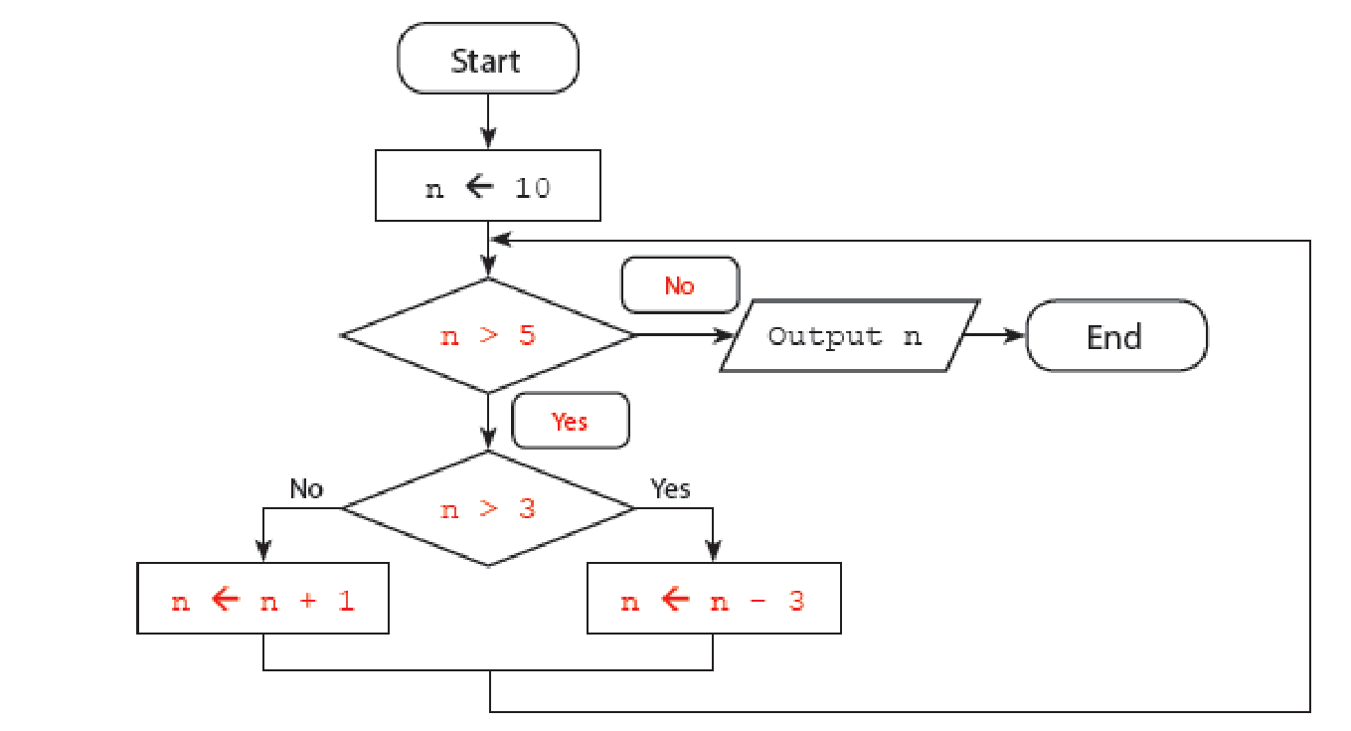
1.1
Answer the questions on P.7 of the textbook.
1(a)
(b) 4

Slide 8

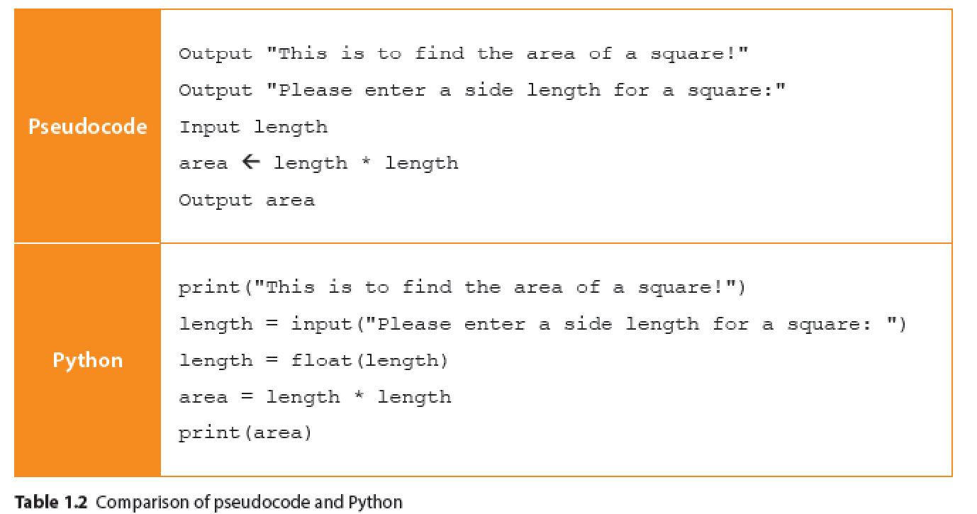
Python Programs
1.2
From pseudocode to programming languages
Pseudocode is not a language that computers can understand. Therefore, we need to communicate with computers using a programming language (e.g. Python). The following are algorithms for calculating the area of a square, which are written in pseudocode and the programming language Python respectively:

Slide 9
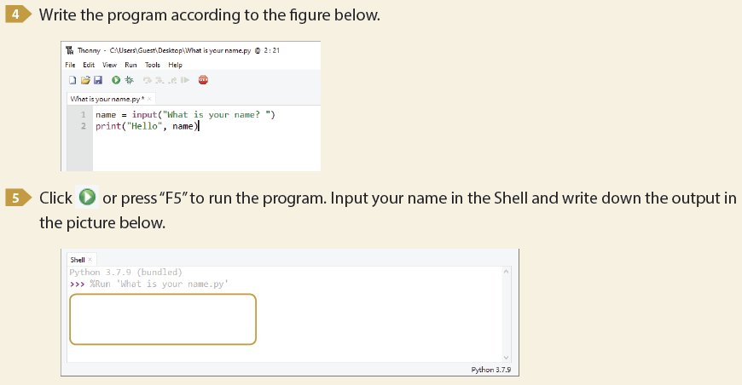
1.1
What is your name?

Slide 10
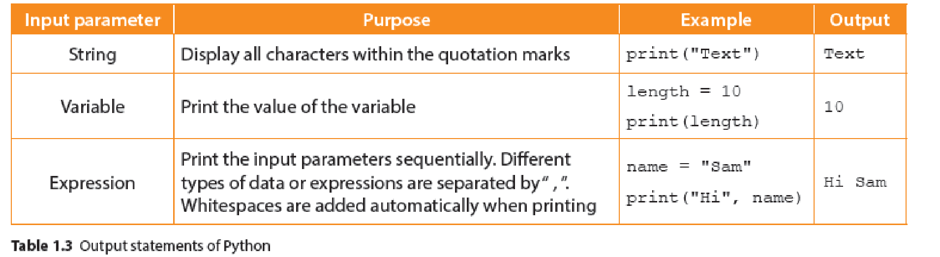
Basic Programming Concepts
1.3
Output statements
In Python, the print() function prints the input parameter in the brackets to the console. The input parameter can be strings, variables or expressions:

Slide 11
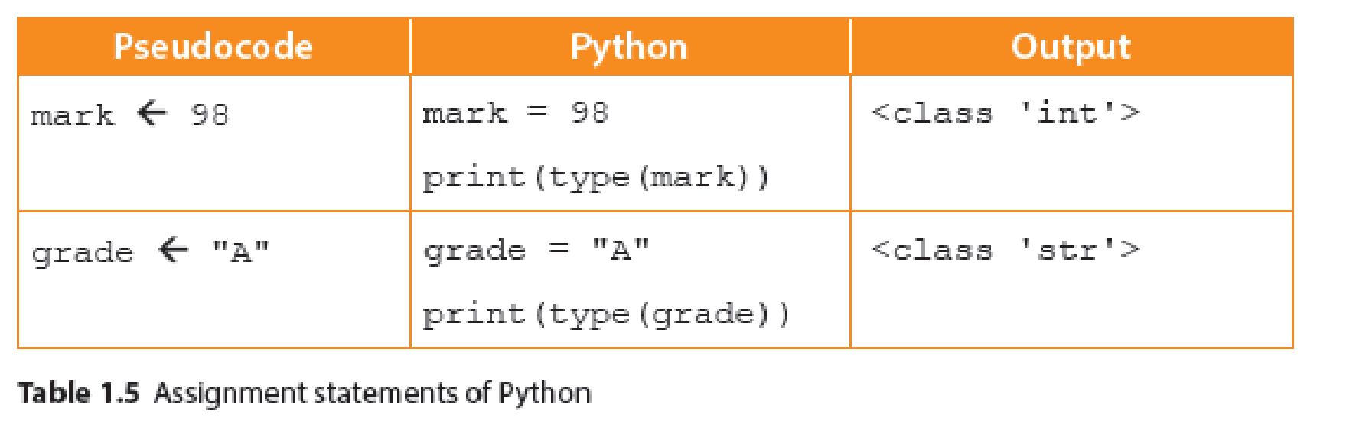
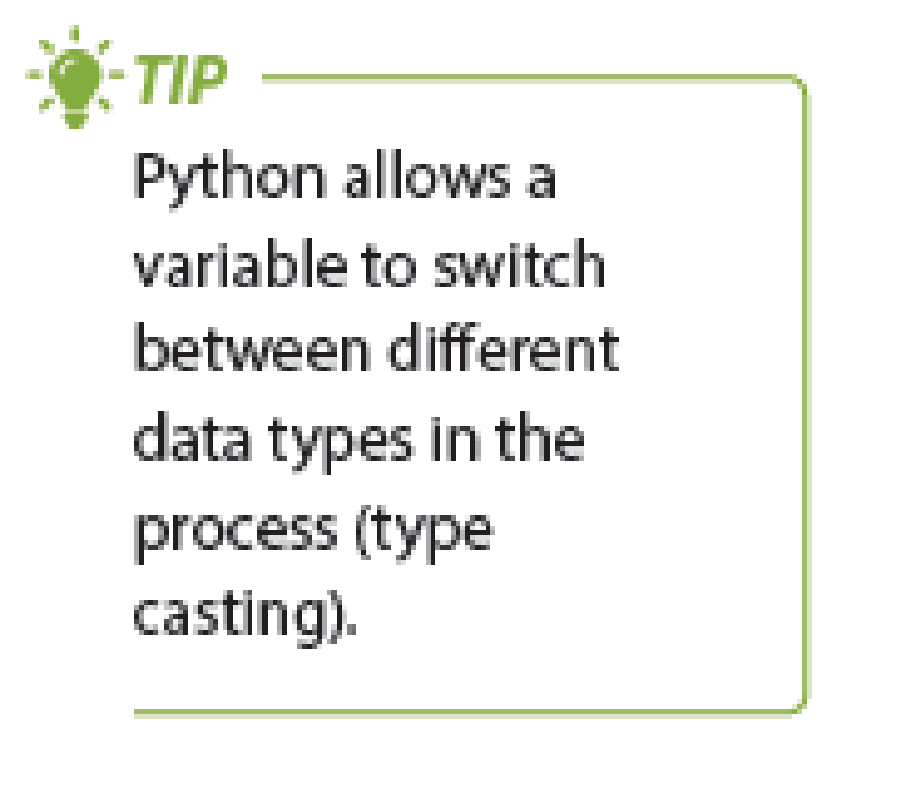
Variables and simple data types
B
Unlike most programming languages, Python declares the data types of variables by tagging values directly during assignments. Python uses “=” as the assignment operator to put data into a specified variable, then automatically tags the data type of the variable according to that of the piece of data. The following are examples of assignment and tagging of variables:

Slide 12
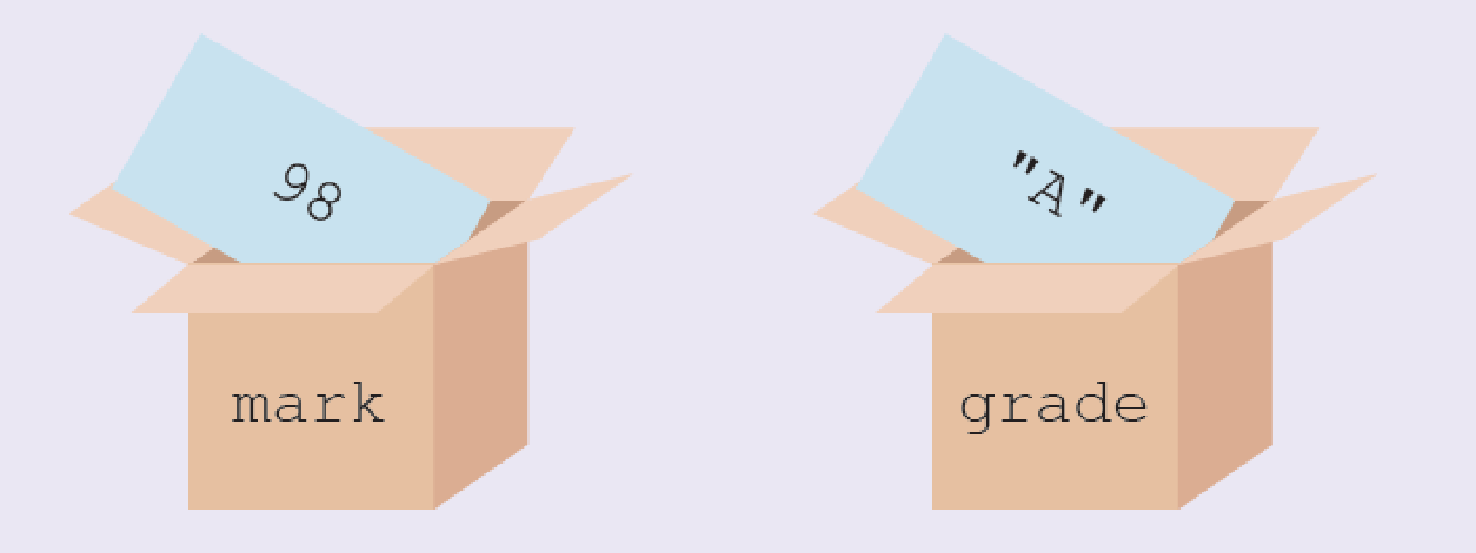
Variables are very similar to algebra that we have learnt in Mathematics. Besides, they are like boxes for storing objects in our daily life. A name is labelled on each box for identifying the content. Variables can store various types of data, such as numbers or text. Different data types will be explained in detail later.

Slide 13
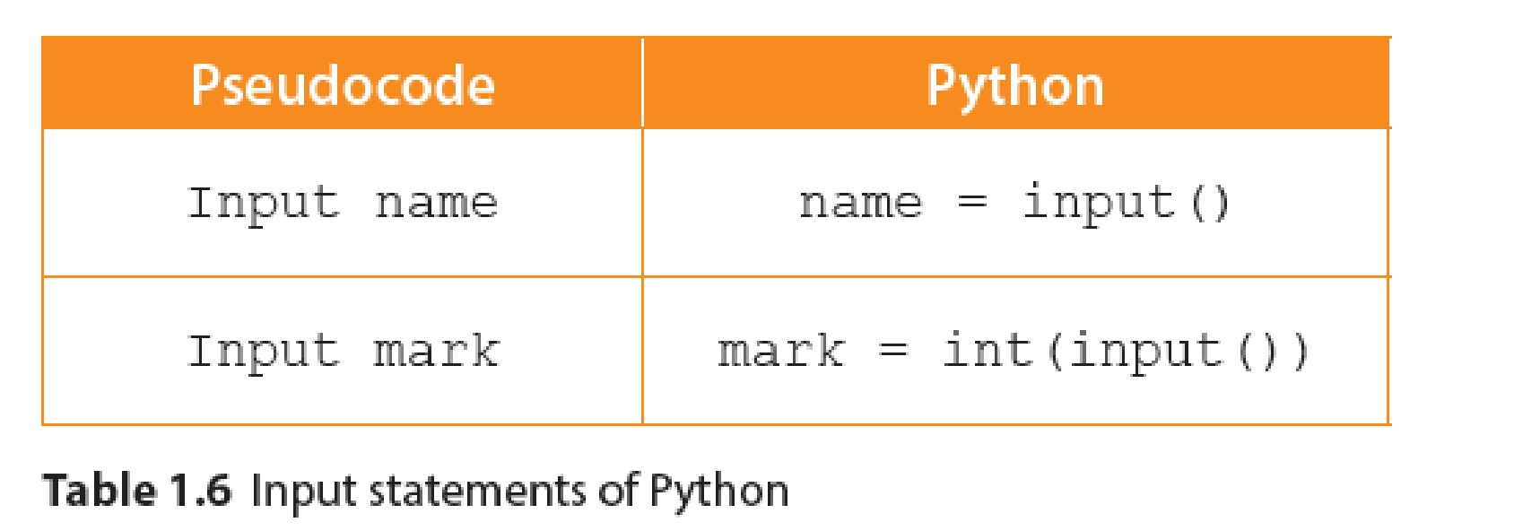
Input statements
C
Python asks users to input data by themselves through the input() function. The input obtained will be stored as a string in a variable. If we need to change its data type, we may use the int() or float() function.
Printing instructions before receiving the users’ input allows them to know what they need to input. If we add a string into the input() function, the program prints a message before the keyboard cursor on the same line. For instance, “name = input("Please input your name: ")”.

Slide 14
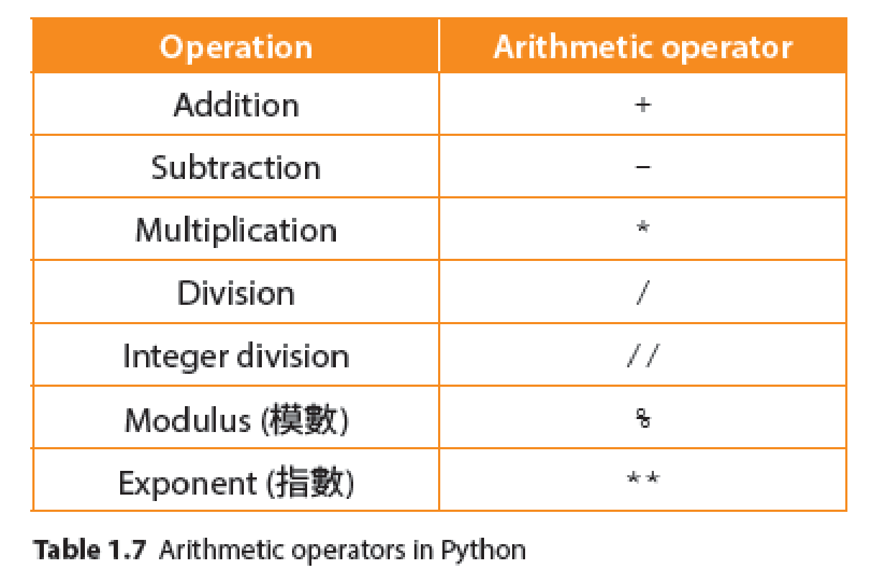
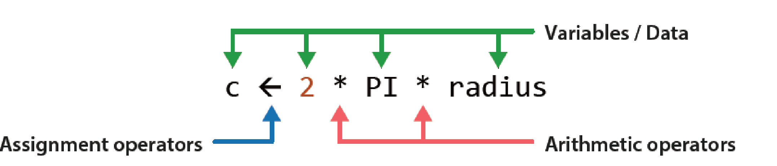
Arithmetic expressions
D
Programs often perform arithmetic calculations. We can use arithmetic operators to process data related to numbers (also known as operand) and store the results of the arithmetic expressions in variables.

Slide 15
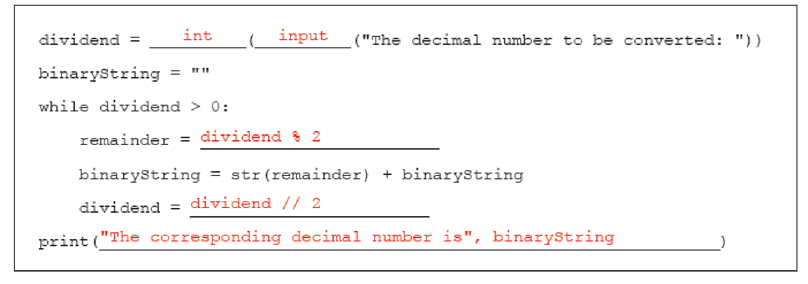
1.2
Answer the questions on P.14 of the textbook.
1.

Slide 16
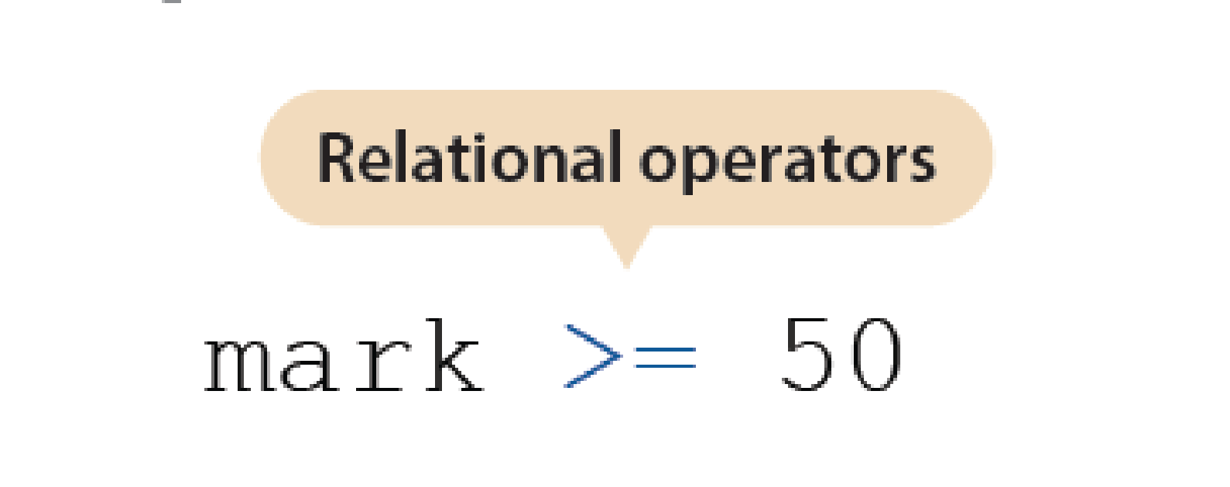
Boolean expressions
E
Relational operators
A Boolean expression gives only two possible results: “True” or “False”, so the result belongs to the Boolean data type. Relational operators can be used to create Boolean expressions.

Slide 17
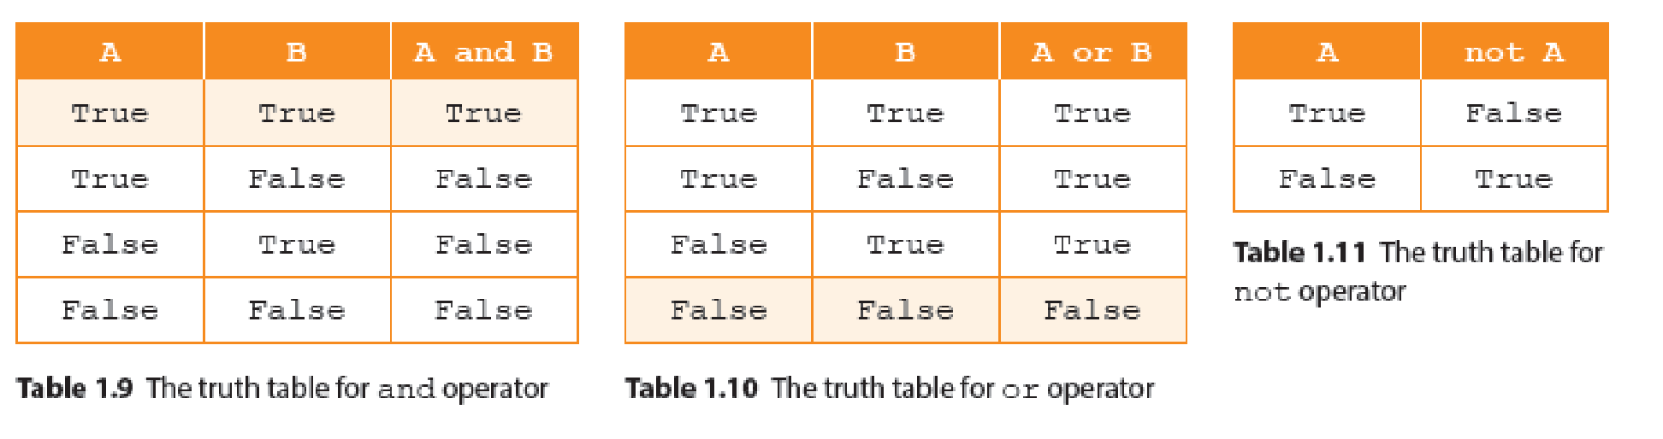
Boolean expressions
E
Boolean operators
Boolean operators (also called logical operators) are used to determine the logical relationship between two conditions. A truth table lists all the combinations of condition evaluation results and the results after logical operations. Assume A and B represent condition 1 and condition 2 respectively. The following tables summarise the truth tables of all Boolean operators.

Slide 18
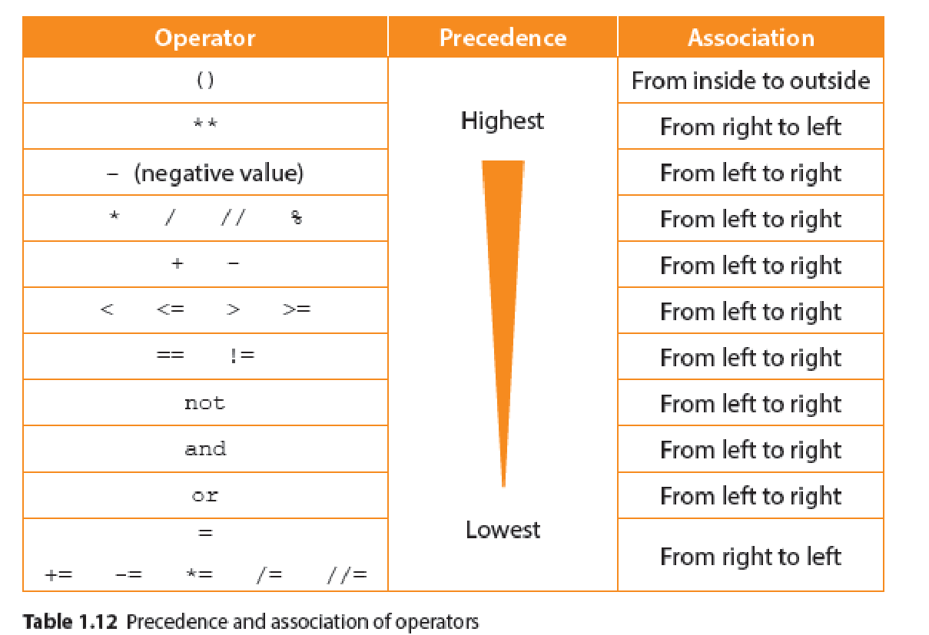
Boolean expressions
E
Precedence and association of operators
Like how we perform arithmetic operations, programs start with the expressions within brackets when processing arithmetic expressions. But how about expressions without brackets? Actually there is a rule similar to PEMDAS for operators. The order of operation is as follows:

Slide 19
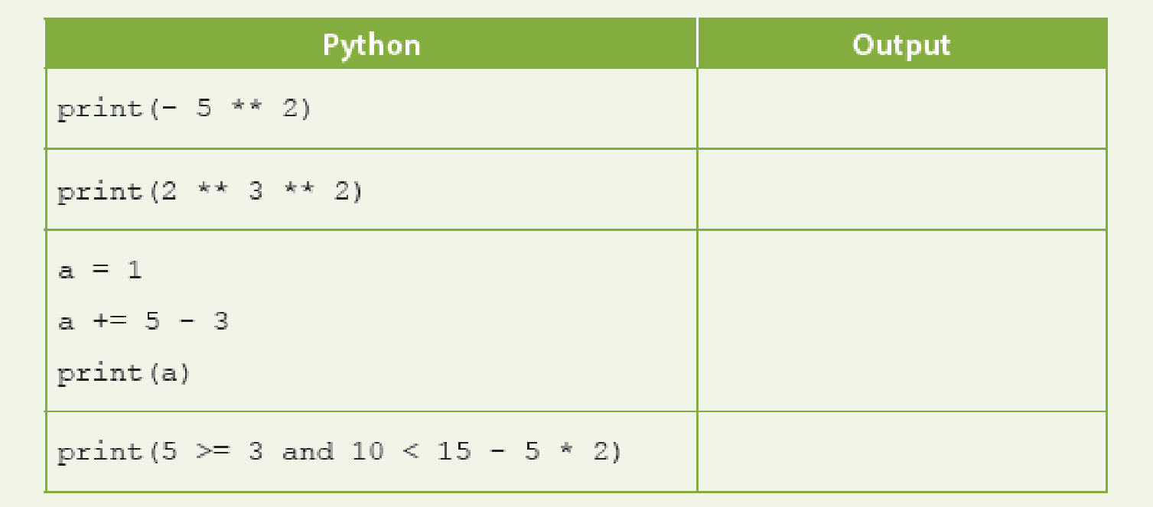
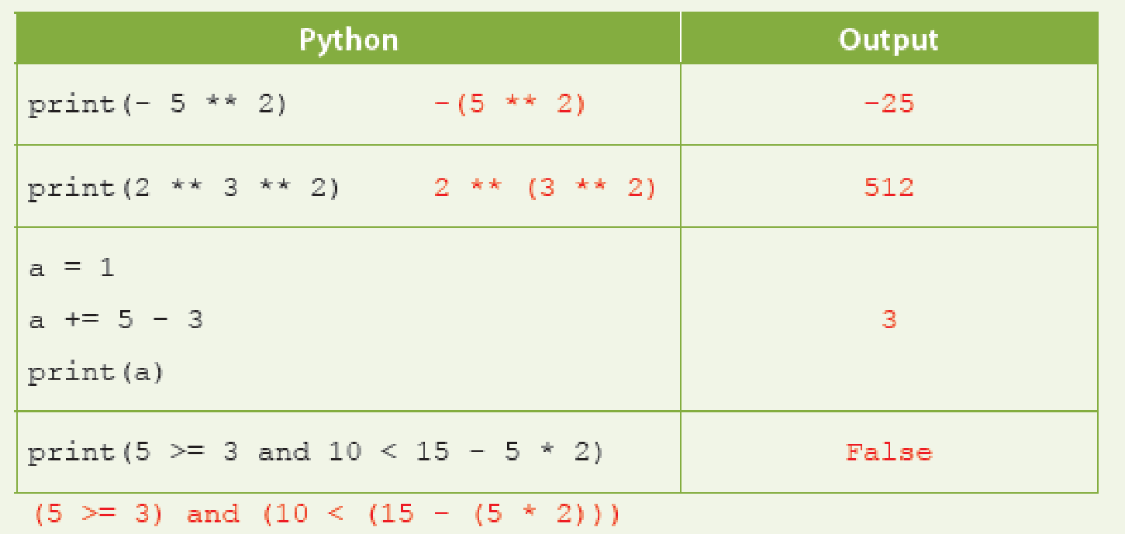
1.2
1. Dry run the following Python codes and write down the output of the programs:

Slide 20
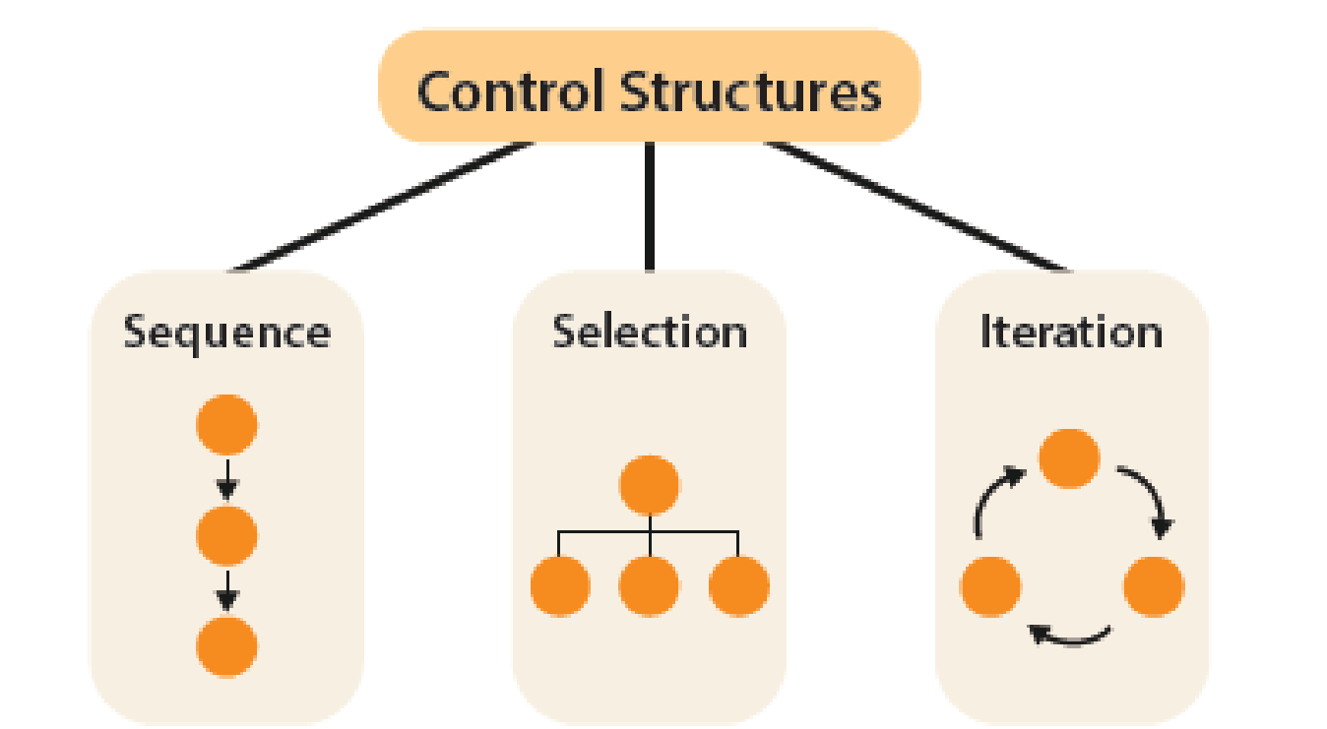
Control Structures
1.4
In computer algorithms, there are three basic types of control structures, including sequence, selection and iteration. The sequence control structure allows the program to execute statements according to the order of writing. Selection and iteration control structures let the program decide which statements to execute according to specified conditions.

Slide 21
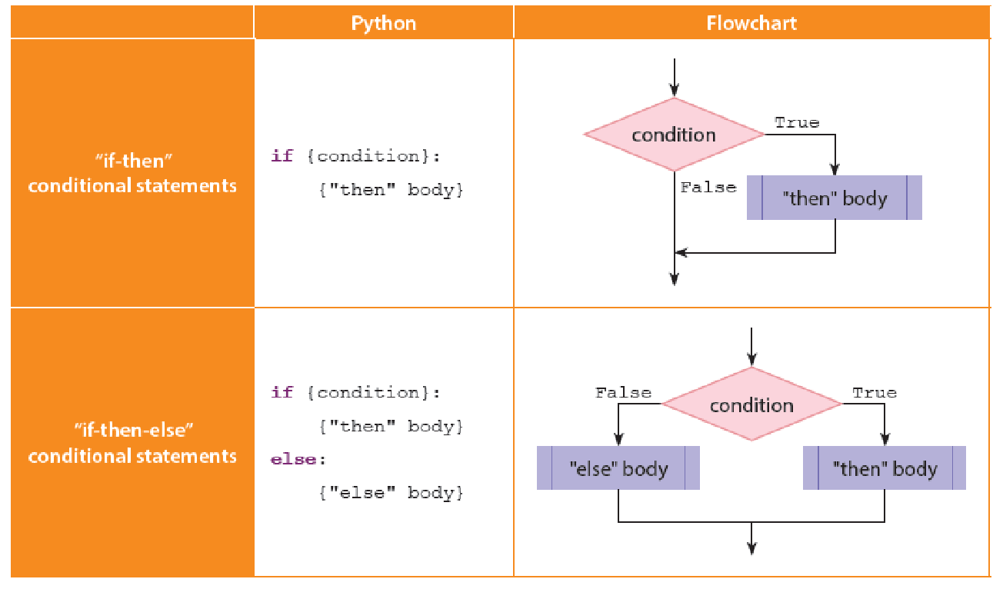
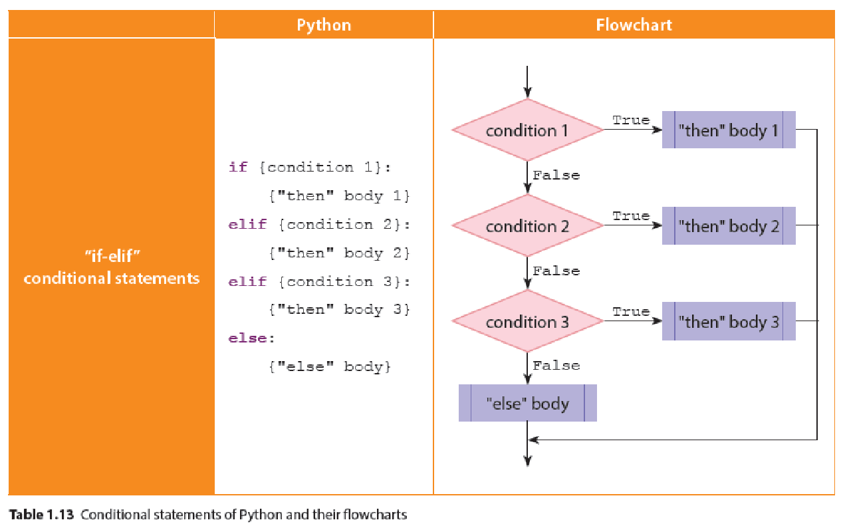
Selection
A
Selection control structure uses a Boolean expression as the condition for evaluation. The logical result will decide which statements the program should execute.

Slide 22
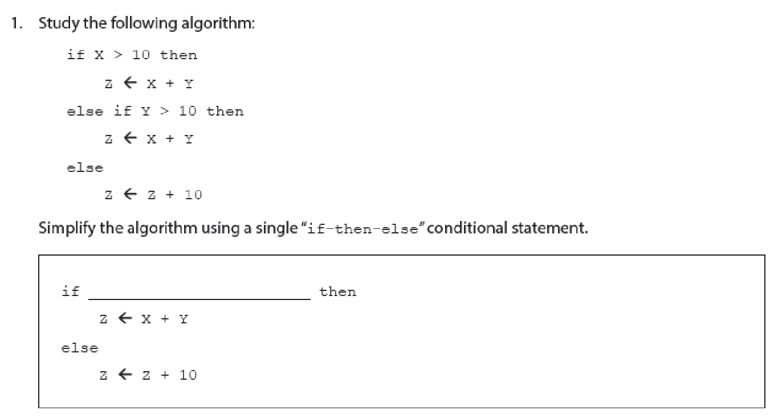
1.1

Slide 23
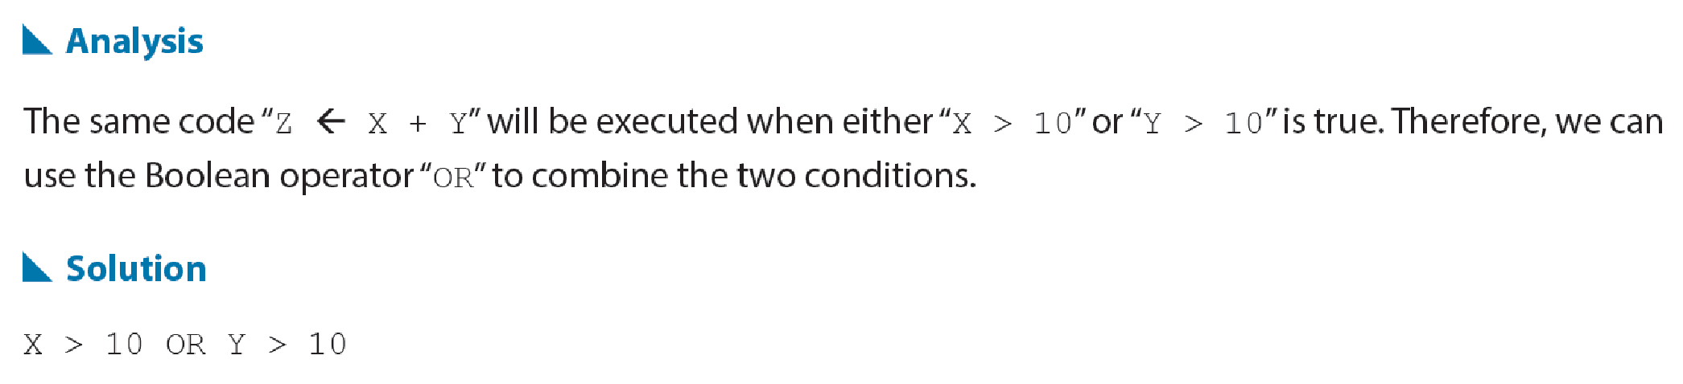
1.1

Slide 24
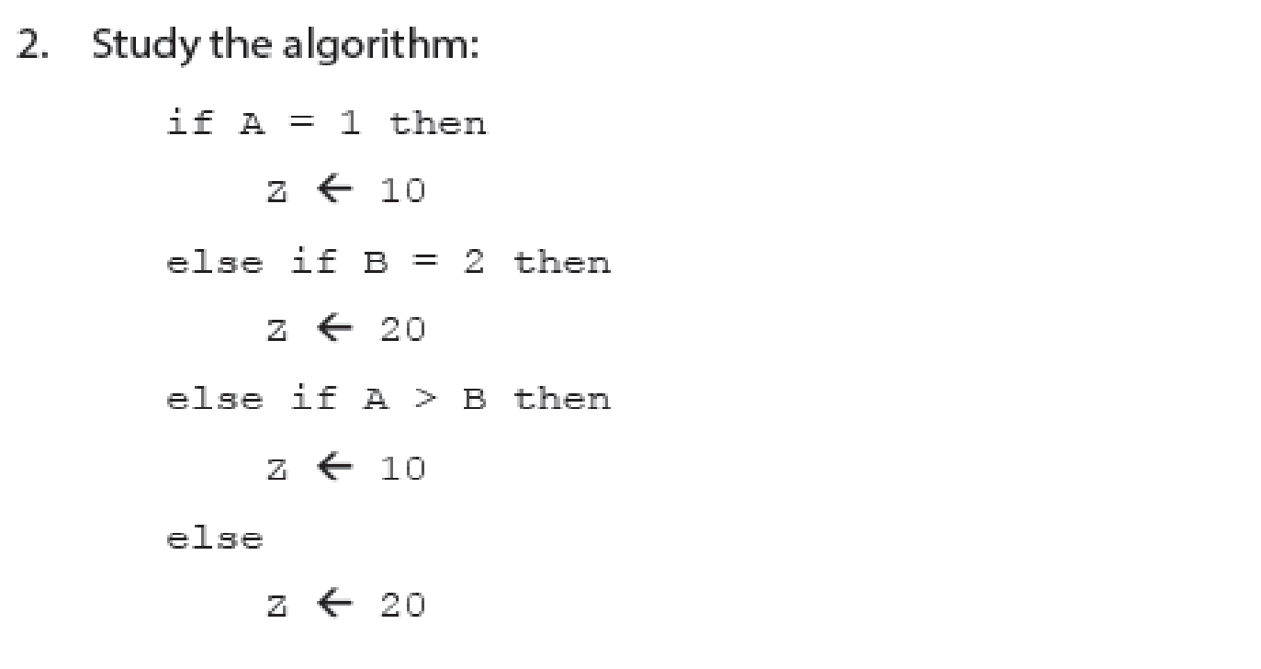
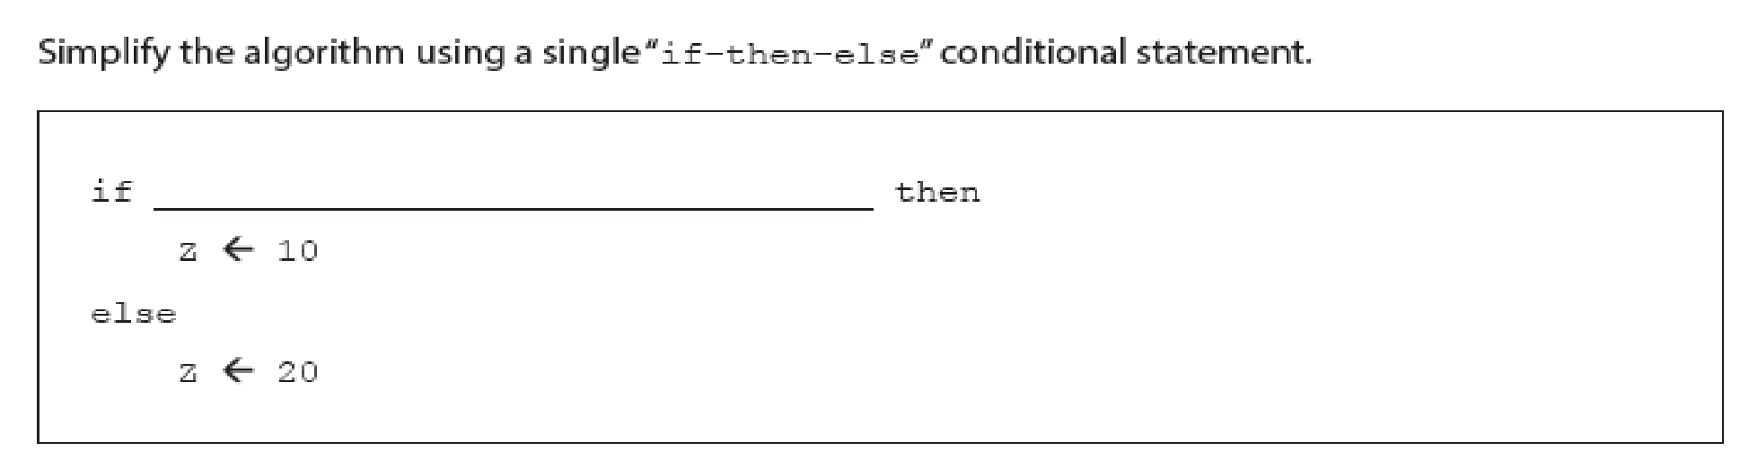
1.1

Slide 25
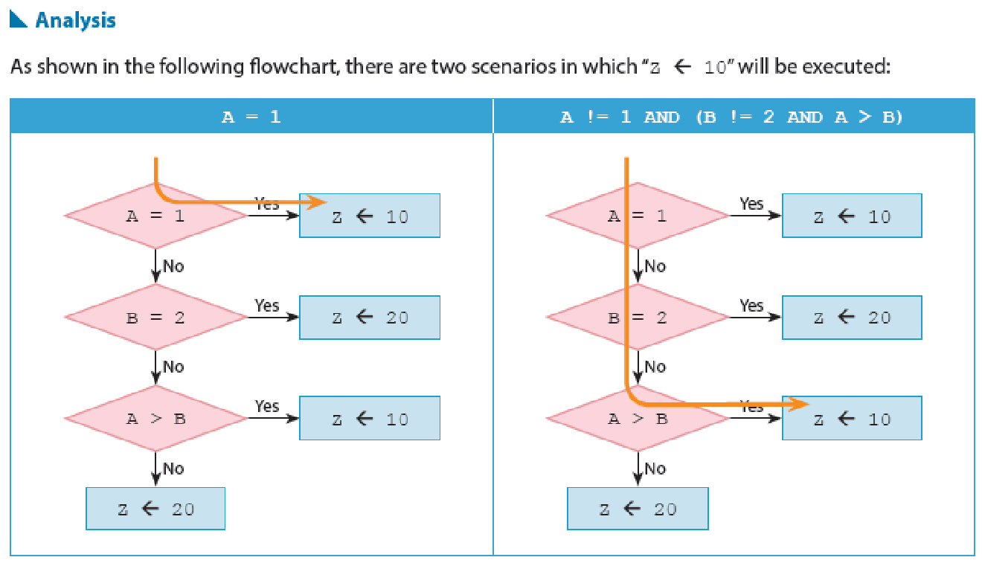
1.1

Slide 26
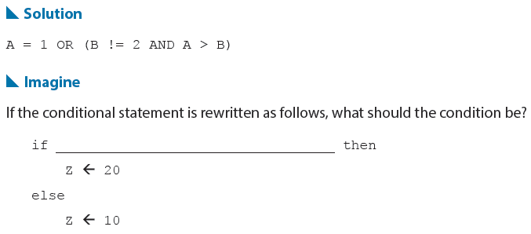
1.1

Slide 27
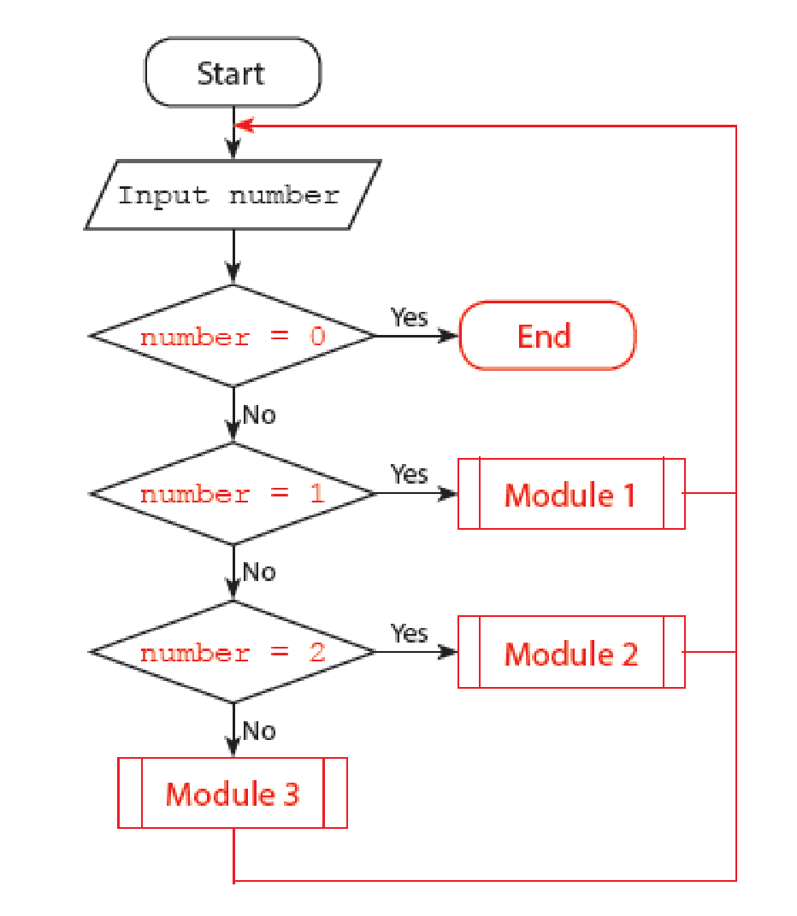
1.3
Answer the questions on P.22 of the textbook.
(a) (i) 1
(ii) 4
(b)

Slide 28
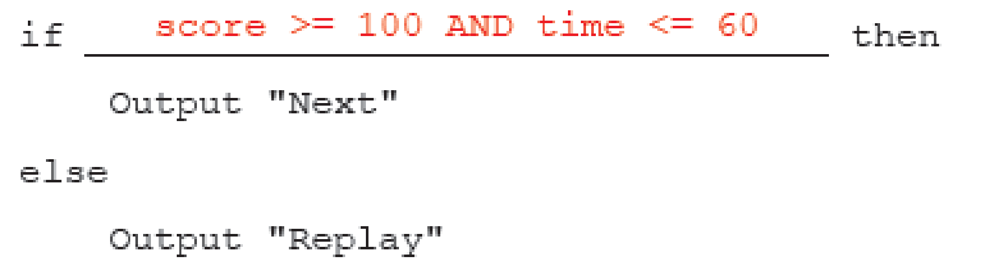
1.3
2.

Slide 29
Iteration
B
The iteration control structure is also called the loop control structure. It means repeatedly executing certain statement(s) until the loop condition is no longer true. The statement(s) to be repeated is called loop body.

Slide 30
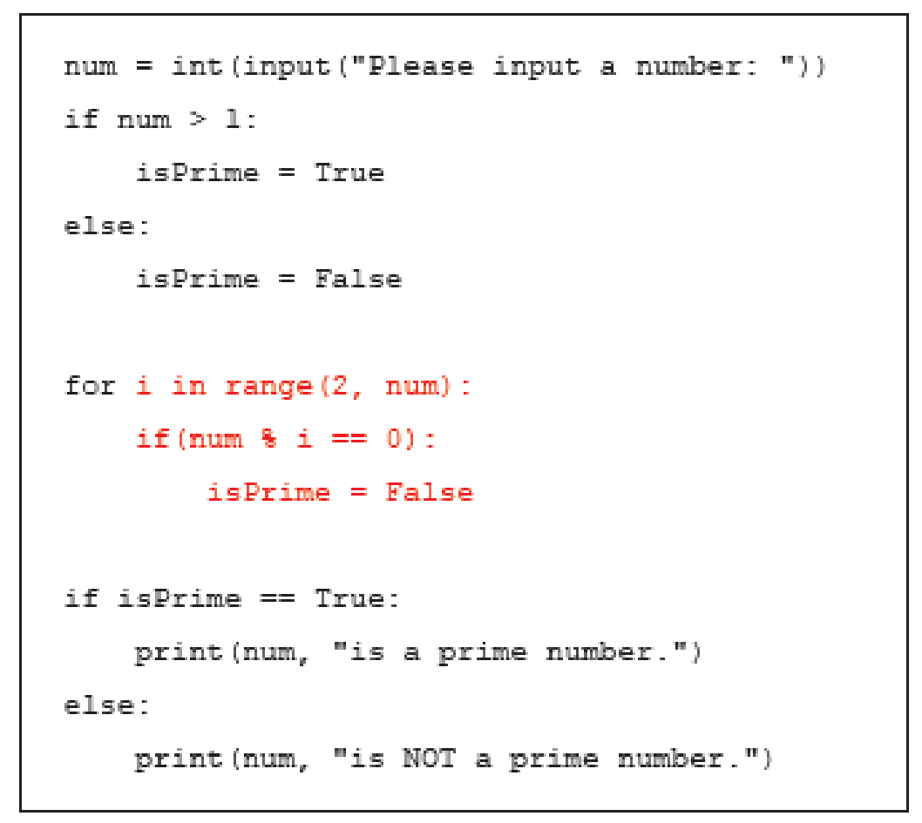
1.4
Answer the questions on P.25 of the textbook.
1.

Slide 31
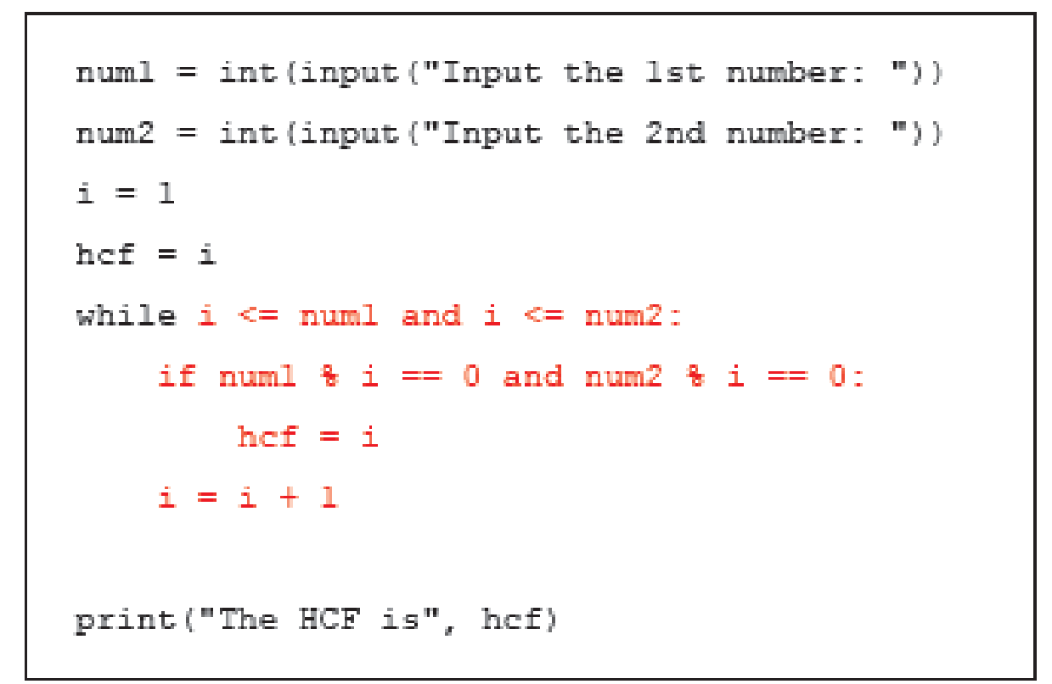
1.4
2.

Slide 32
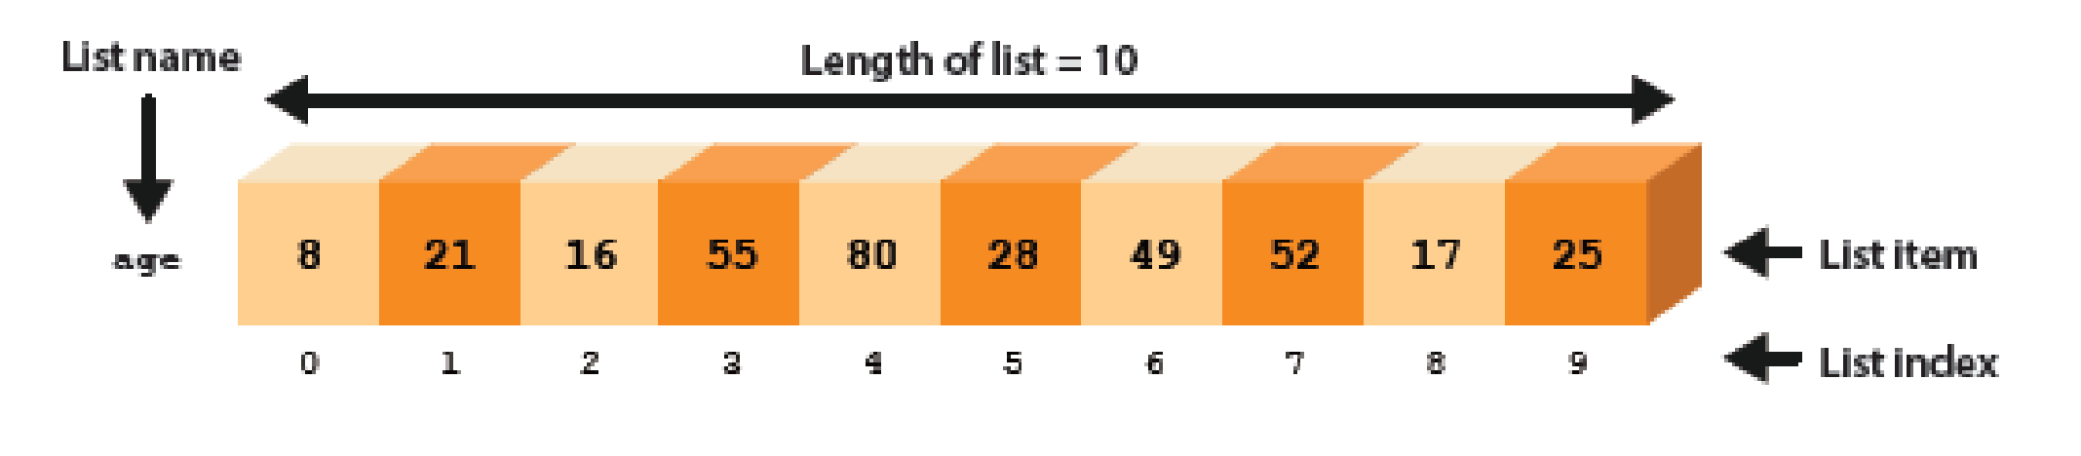
Data Structures
1.5
Data structure helps organising data for easier use. An example is onedimensional array (1D array). It is a simple linear data structure that stores a set of data sequentially in continuous variables. This set of data are often of the same type.

Slide 33
Arrays and Python lists (one-dimensional arrays)
A
The above diagram illustrates how a list is presented in a linear data structure. age[0] stands for the first piece of data in the list, age[1] the second piece, and so on. This means the value of age[0] is 8 and that of age[1] is 21.
Apart from connecting a lot of related data, lists facilitate the use of loops to implement different algorithms, such as algorithms of counting and accumulating.

Slide 34
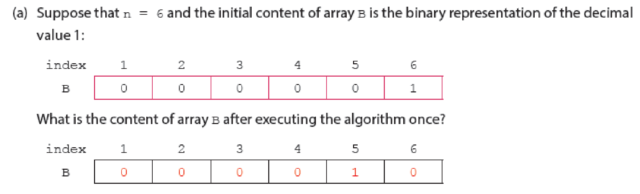
1.5
Answer the questions on P.28 of the textbook.
1.

Slide 35
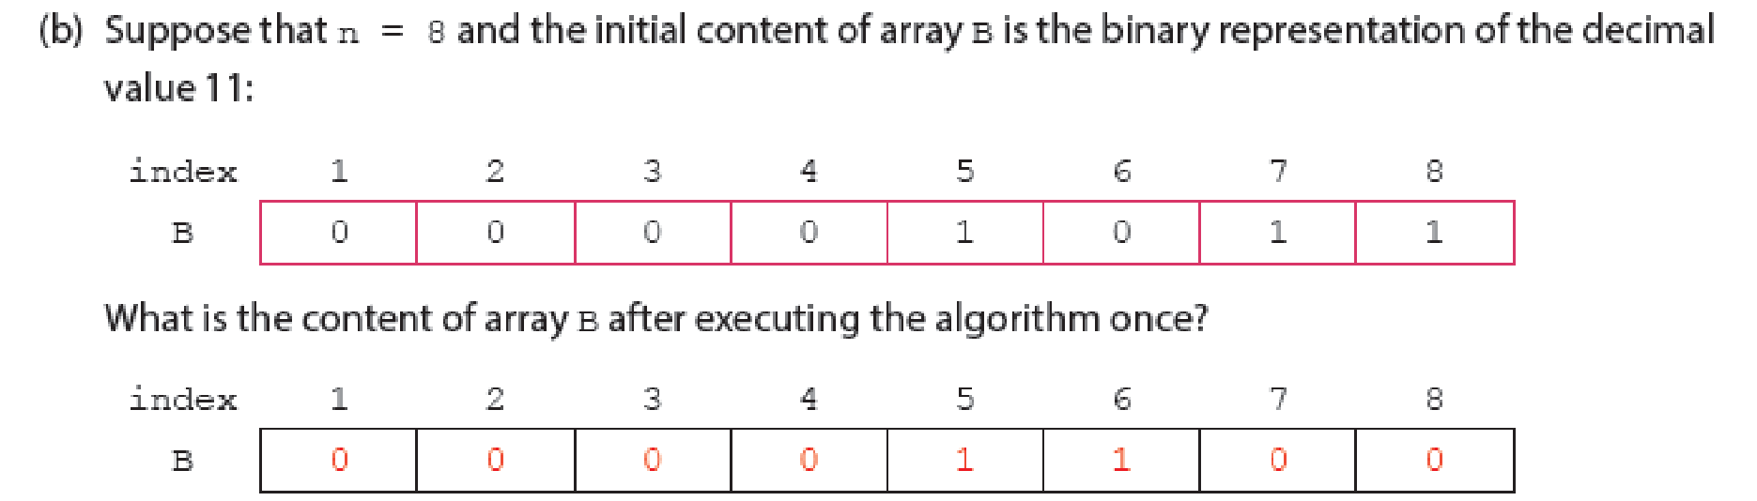
1.5
(c) Add 1 to the number in binary representation in array B
(d) Accessing an item outside the range of the array index

Slide 36
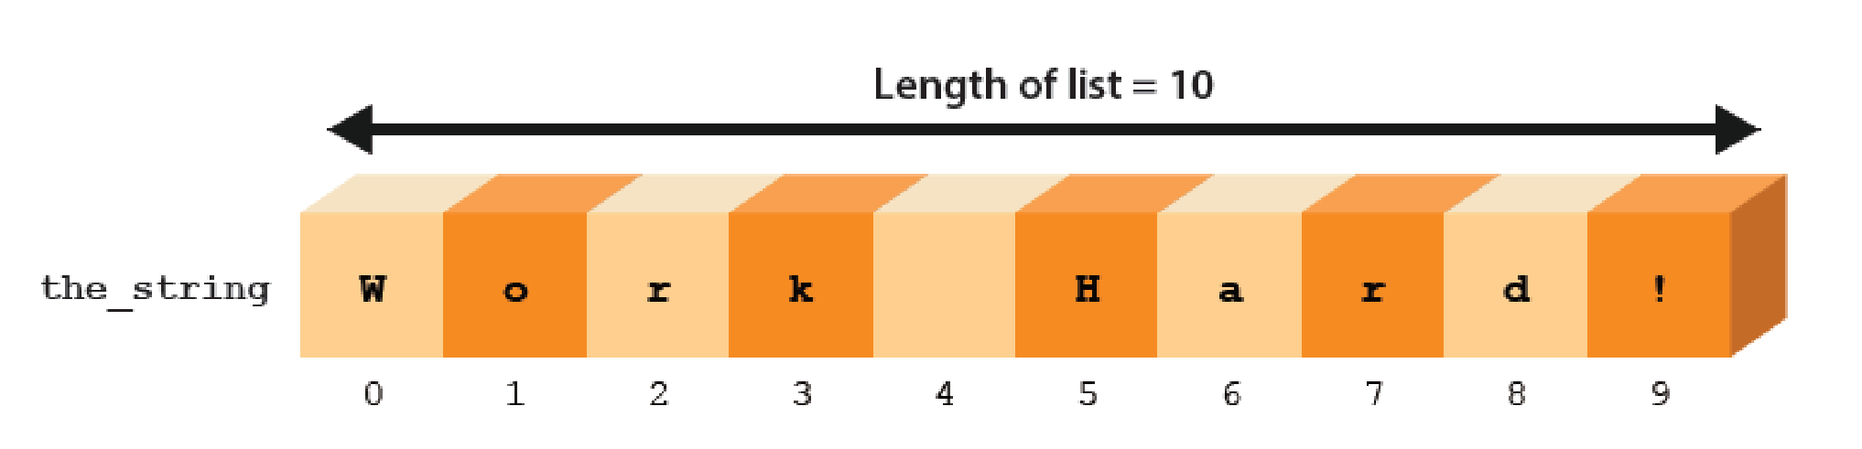
Strings
B
A string is formed by a series of characters. In the following example, the characters in the string "Work Hard!" are placed in a list named the_string, i.e. the value of the_string[0] is 'W'.

Slide 37
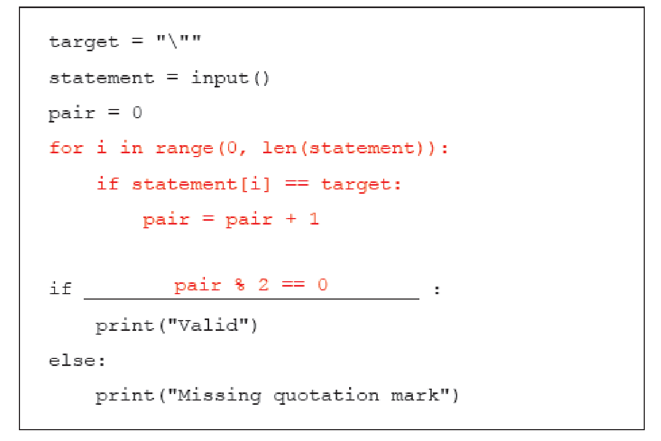
1.6
Answer the questions on P.31 of the textbook.
1.(a)(i) Valid
(ii) Missing quotation mark
(b)

Slide 38
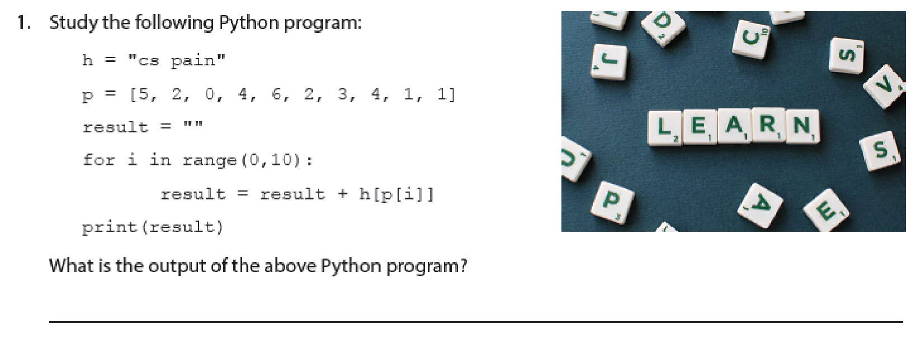
1.2

Slide 39
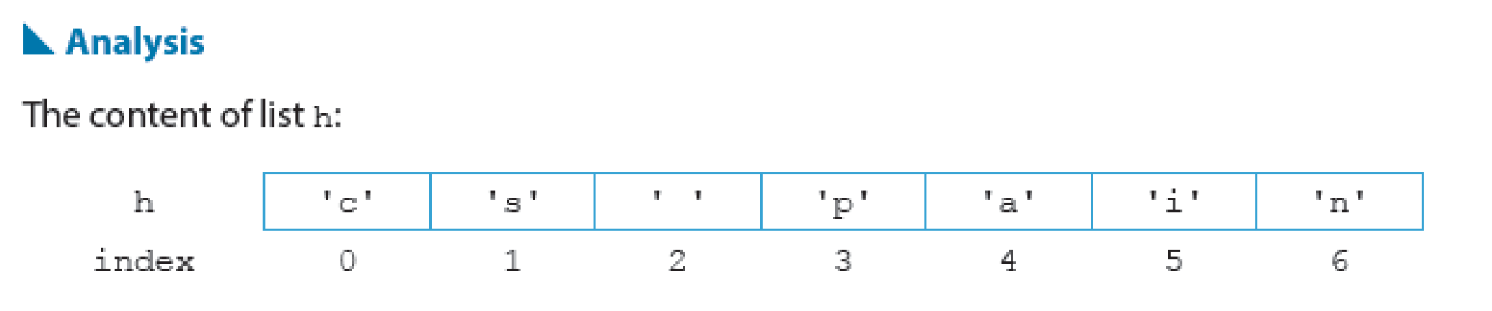
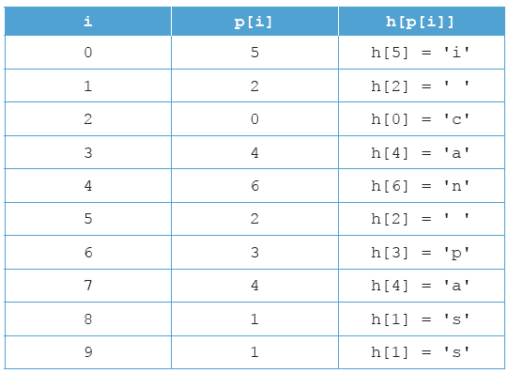
1.2

Slide 40

1.2

Slide 41
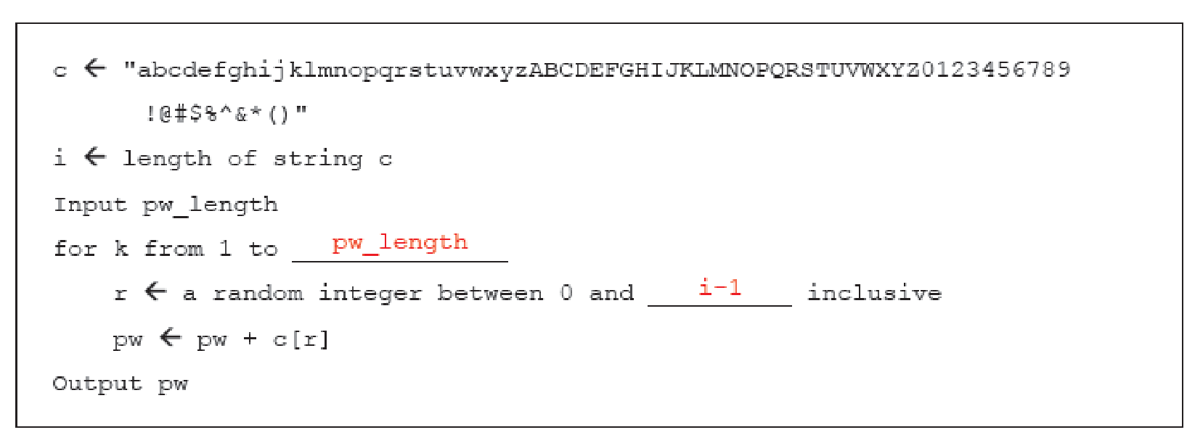
1.7
Answer the questions on P.33 of the textbook.
1.

Slide 42
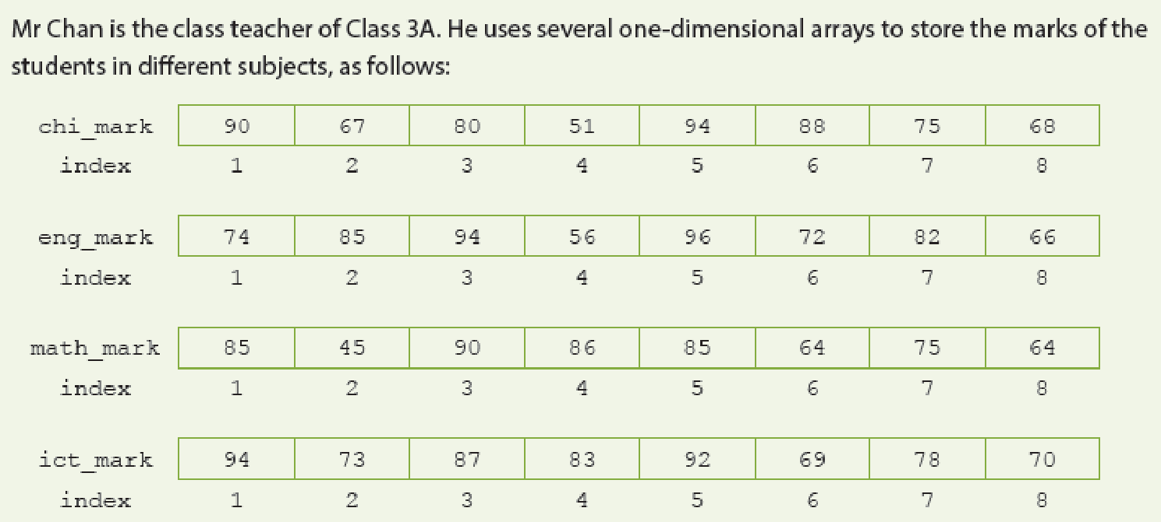
1.3

Slide 43
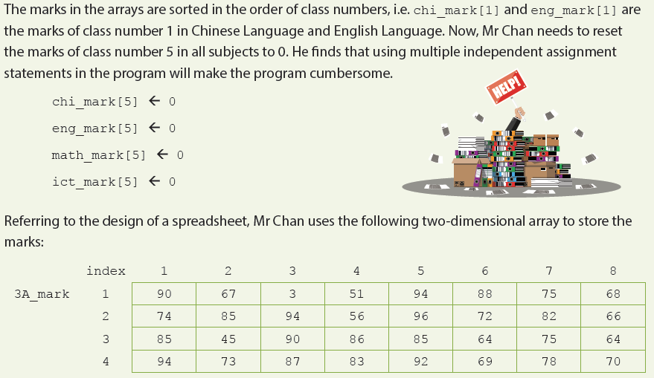
1.3

Slide 44
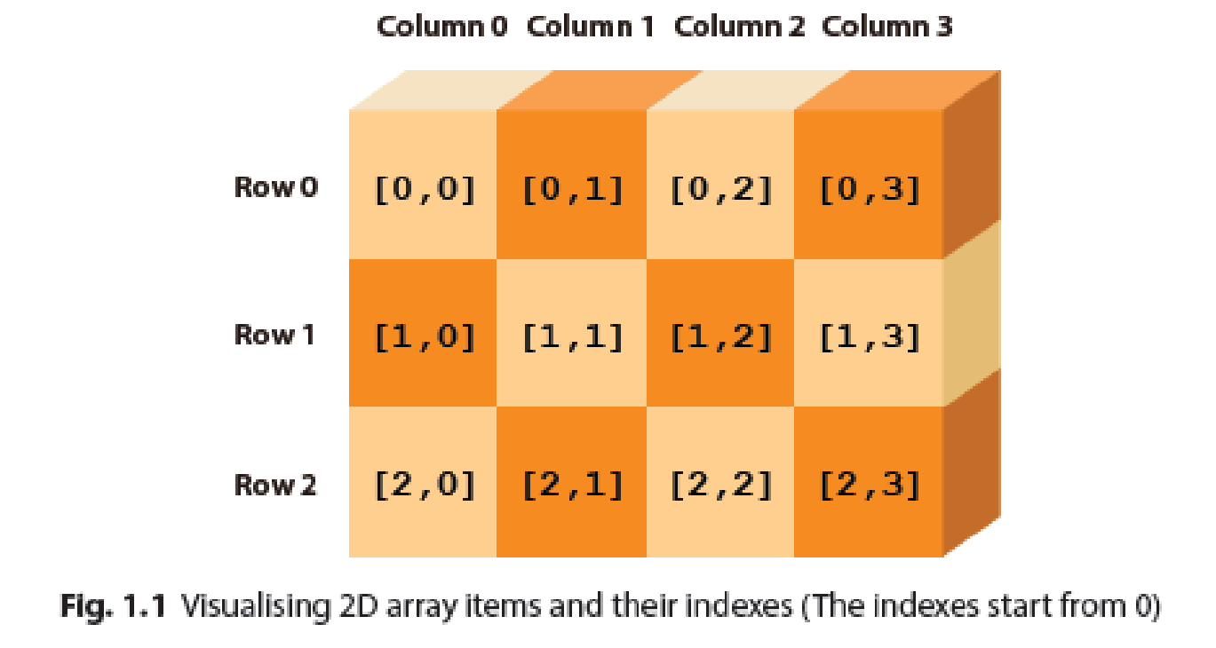
Two-dimensional arrays
C
Arrays are not always in the form of lists. They can also present data in the form of tables or matrixes, which are called two-dimensional arrays (2D arrays). For instance, when writing a “tic-tac-toe” or “minesweeper” game, we can use two-dimensional arrays to create forms for storing data of different locations.

Slide 45
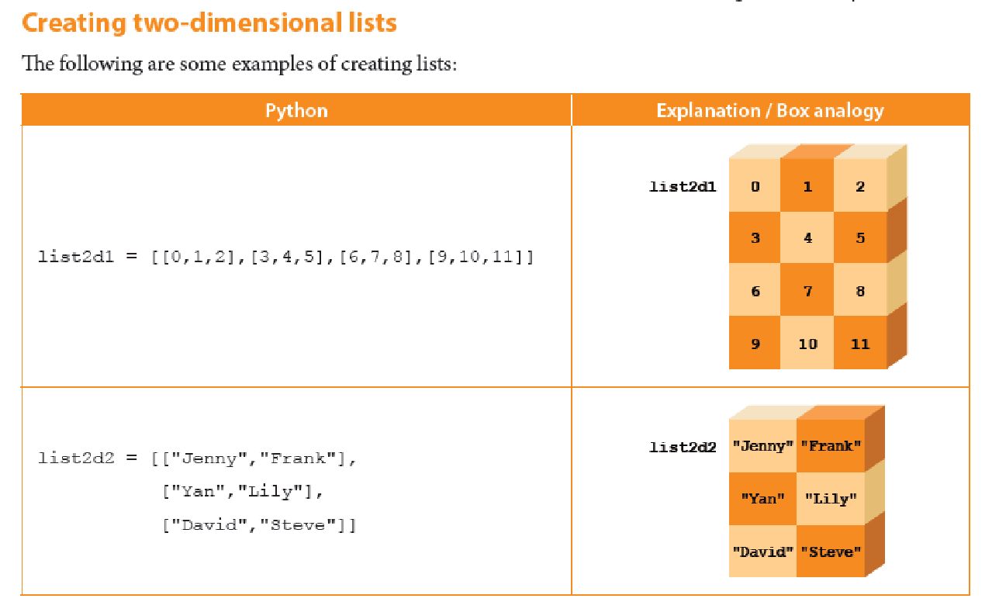
Two-dimensional arrays
C

Slide 46
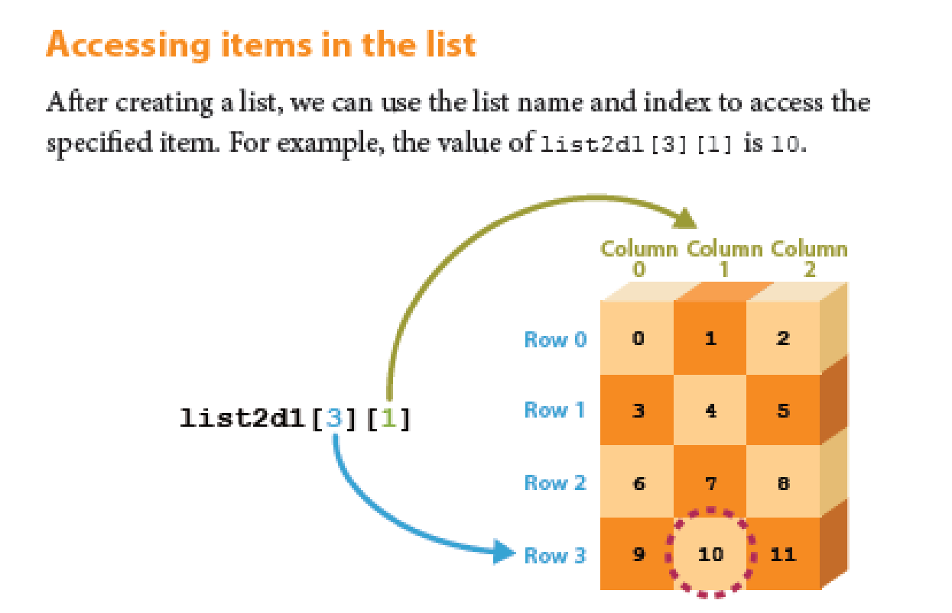
Two-dimensional arrays
C

Slide 47
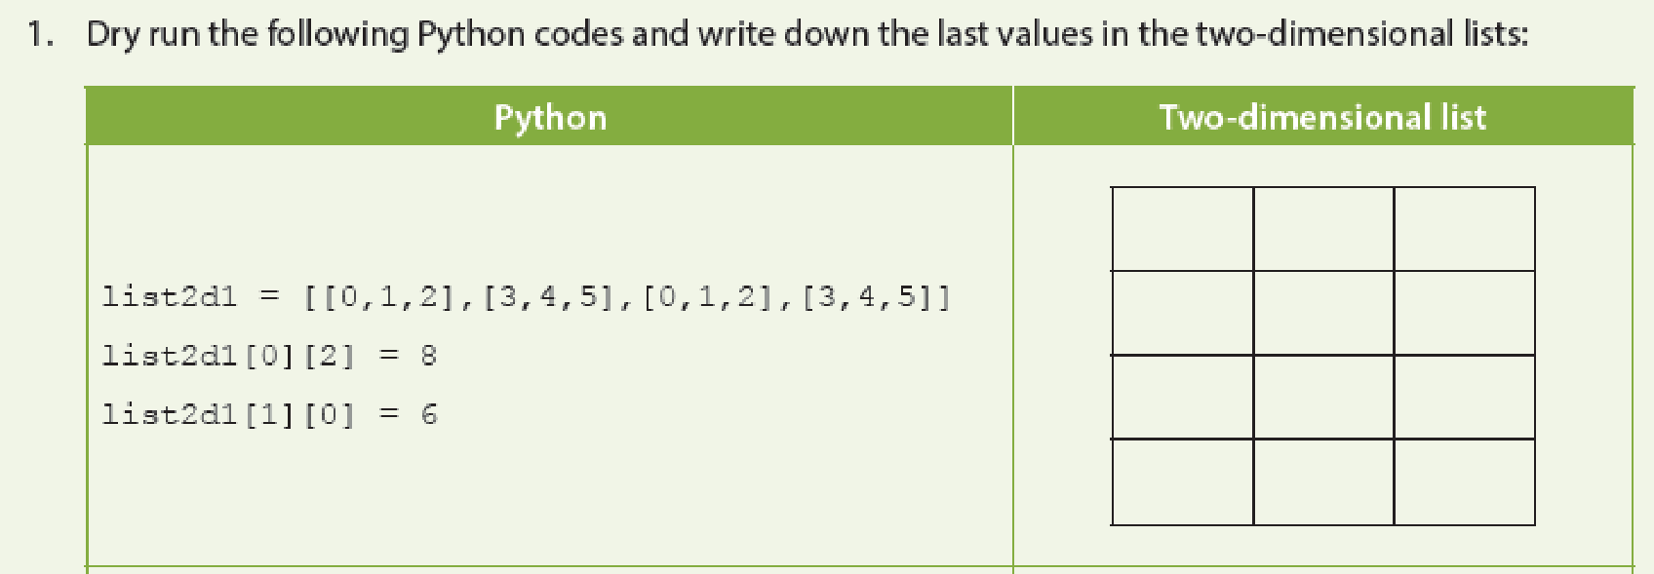
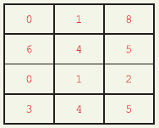
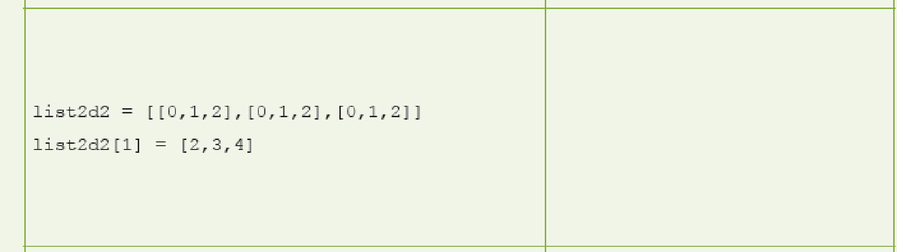
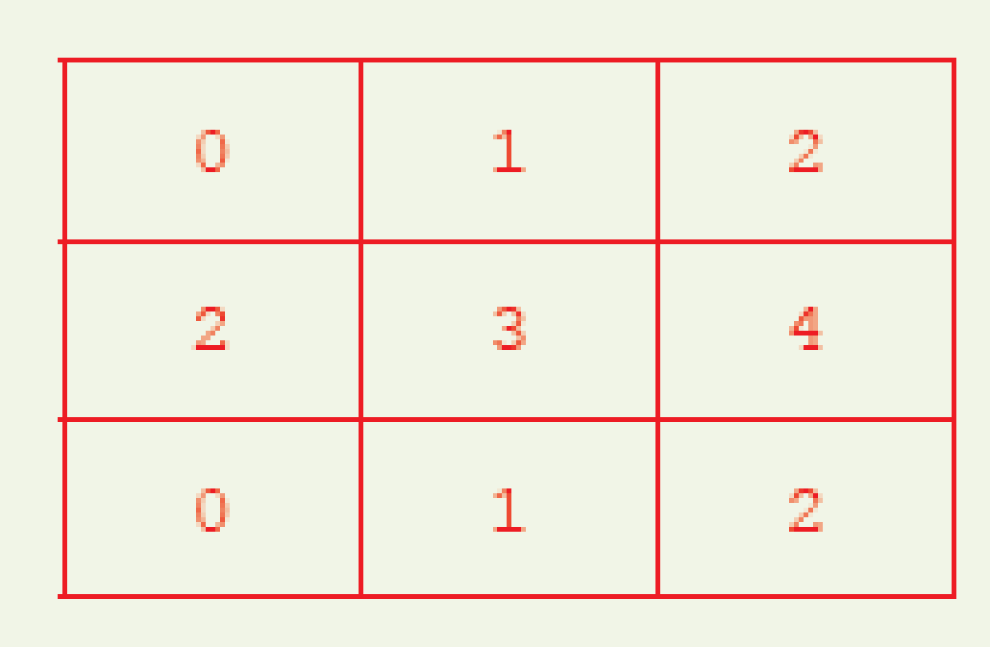
1.4

Slide 48
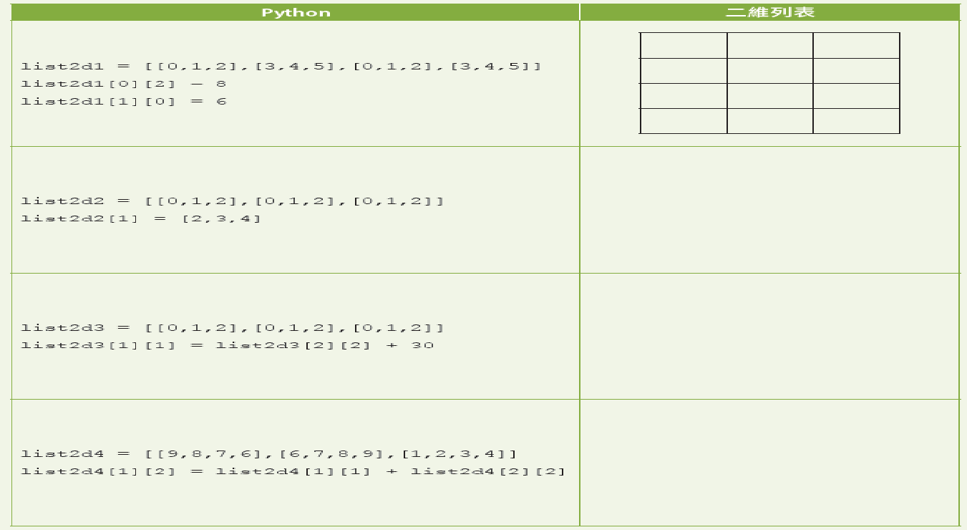


1.4

Slide 49

1.3

Slide 50

1.3

Slide 51


1.3

Slide 52


1.3

Slide 53

1.8
Answer the questions on P.42-45 of the textbook.
1.

Slide 54


1.8
2. (a)(i) 45
(ii) 6
(b)
(c)

Slide 55

1.8
3.

